Slide 1
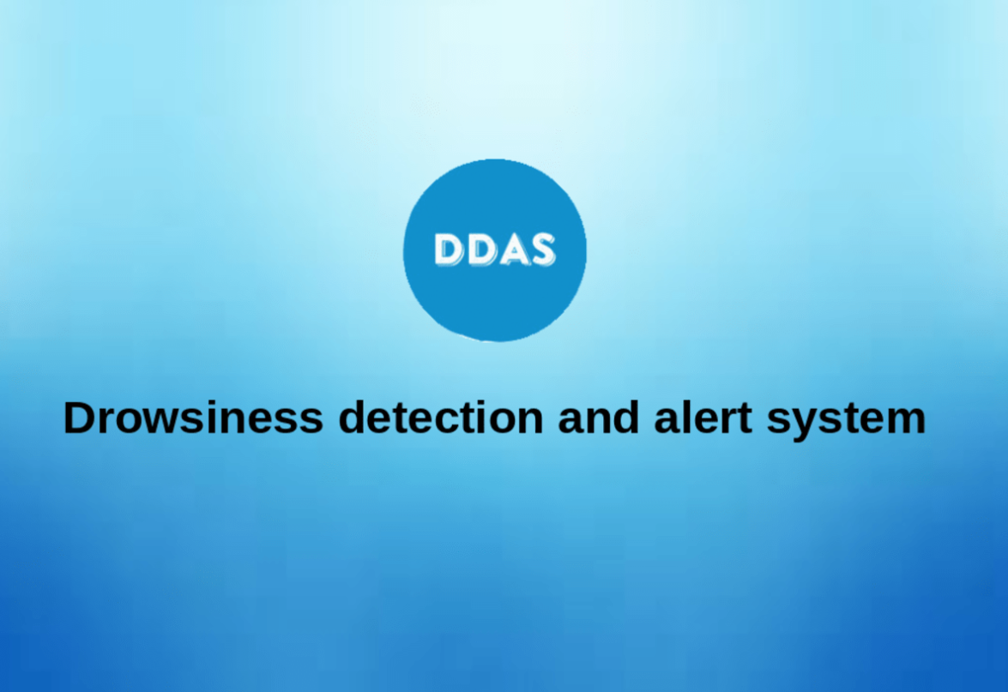
By:
Manoj, Nishanth, Jaswanth

Slide 2
DROWSINESS DETECTION
Drowsiness and Fatigue of drivers are amongst the significant causes of road accidents. Every year, they increase the amounts of deaths and fatalities injuries globally.

Slide 3
Project Description
This is a computer vision system that can automatically detect person drowsiness in a real-time video stream and then play an alarm if the driver appears to be drowsy.
This system can be implemented in the field where we need to test the alertness of the person.
Eye aspect ratio algorithm is used to detect whether the person is drowsy or not.
When we detect that the person is drowsy or sleeping we can alert him through some sound alerts.
We can inform the authorities when the worker is drowsy or sleeping by sending them messages, so that he can take necessary actions

Slide 4
Drowsiness detection and alert system:-
The Drowsiness Alert device has the capability to detect the drowsiness, With the help OpenCV, Python, dlib, imutils to create facial landmarks and checking the EAR(eyes aspect ratio) value to detect drowsiness

Slide 5
What do Drowsiness detection and alert system do?
The device continuously monitors the driving condition of the driver. If the device detects a change in the condition if the person is drowsy the device turn on an alarm/beep. The alarm can act as a signal to alert everyone so that they can be saved from the accidents

Slide 6
Detecting Eye Blinks with Facial Landmarks

Slide 7
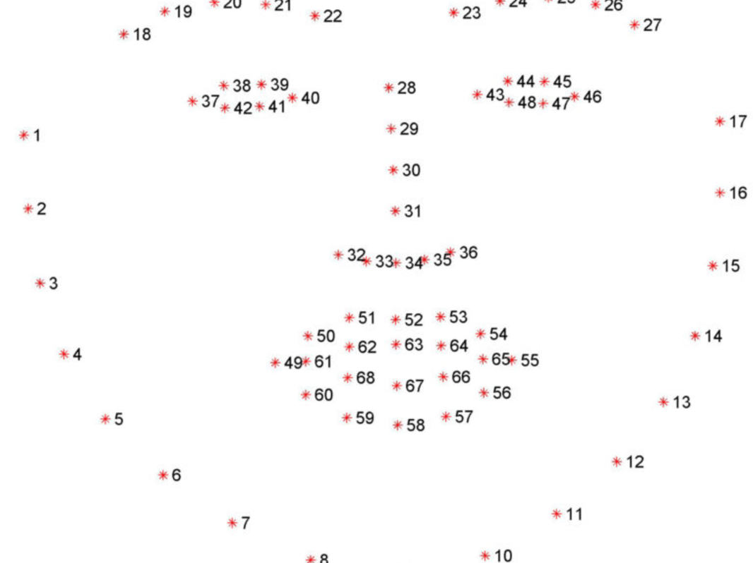
Eye blinks can be detected by referencing significant facial landmarks on the face. There are many software libraries that can plot significant facial features within a given region of interest. Python's dlib library uses Kazemi and Sullivan's One Millisecond Face Alignment with an Ensemble of Regression Trees to implement this feature. The program uses a facial training set to understand where certain points exist on facial structures. The program then plots the same points on a region of interests in other images, if they exist. The program uses priors to estimate the probable distance between key points. The library outputs a 68 point plot on a given input image. For eye blinks, we need to pay attention to points from 37 to 46, the points that describe the eyes

Slide 8
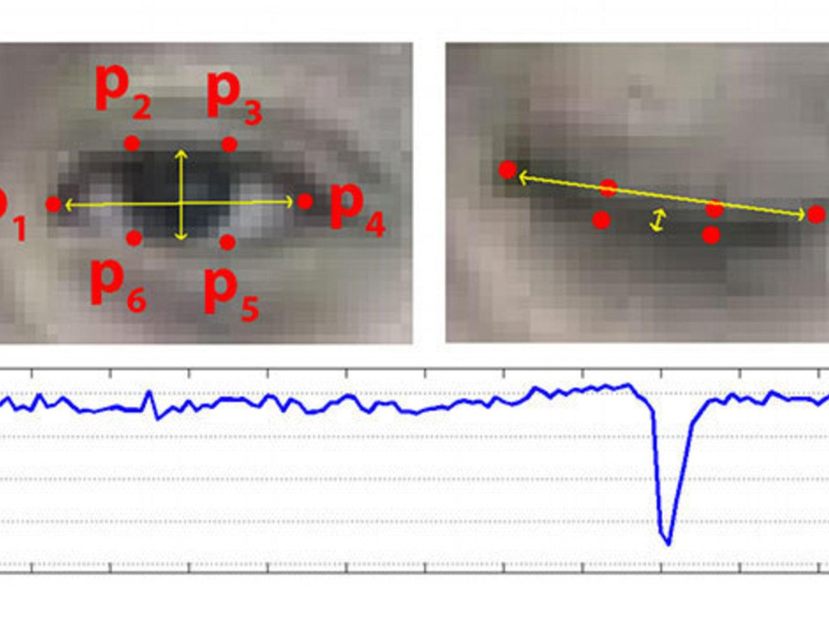
In Real Time Eye Blinking Using Facial Landmarks, that represents the Eye Aspect Ratio. The Eye Aspect Ratio is an estimate of the eye-opening state. They proposed a simple but efficient algorithm to detect eye blinks by using a recent facial landmark detector. A single scalar quantity that reflects a level of the eye-opening is derived from the landmark

Slide 9
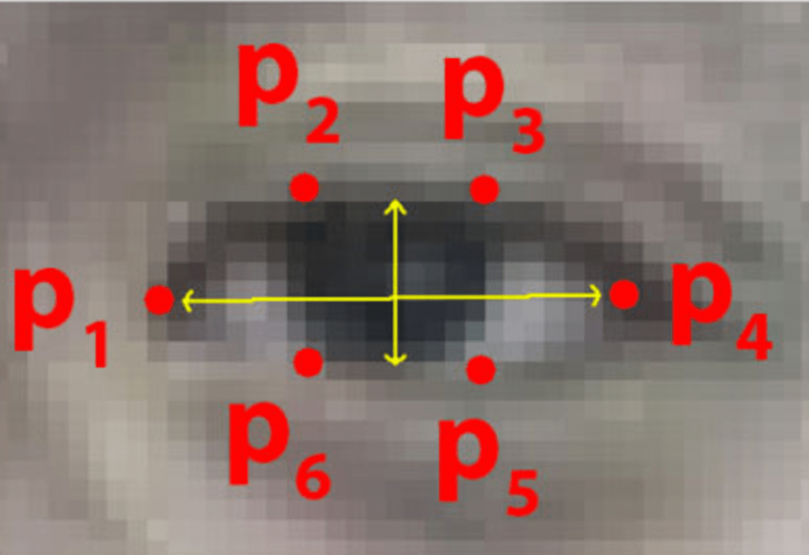
Finally, having a per-frame sequence of the eye-opening estimates, the eye blinks are found by an SVM classifier that is trained on examples of blinking and non-blinking patterns

Slide 10
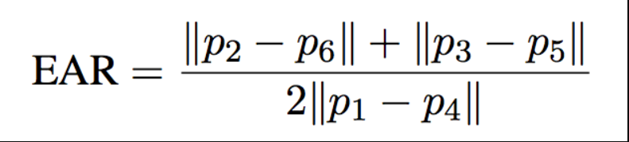
The Eye Aspect Ratio is a constant value when the eye is open but rapidly falls to 0 when the eye is closed. The figure shows a person's Eye Aspect Ratio over time. The person's eyeblinks are obvious

Slide 11
THANK YOU
TEAM AUTOBOTS

